Slide 1

Welcome to React js

Slide 2
React.js
DAY-1
Topics Covered:
What is React.js?
History of React.js
Why do we need React.js?
Without React.js vs With React.js
Prerequisites for Learning React.js
Library vs Framework
SPA vs MPA (Single Page Applications vs Multi Page Applications)
Characteristics of React.js
Virtual DOM vs Real DOM
React.js Applications (Where React is Used?)
Installing React.js with Vite

Slide 3

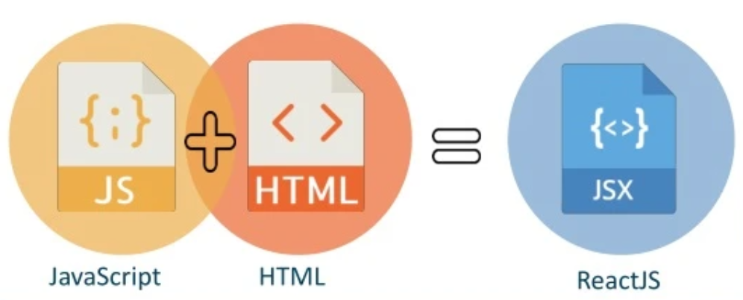
Introduction to React js
Q. What is React.js?
React.js is a Frontend Javascript library used for building user interface (UI’s).
Specially react.js is used to create single-page applications (SPA).
It allows developers to create reusable UI components, making the development process faster and more efficient.

Slide 4

History to React js
Who created React.js?
React.js developed by Jordan Walke, a software engineer at Facebook.
He created react in 2011 as internal tool to improve the performance of Facebook’s News Feed Section.
React was officially released to the public in 2013 as an open-source JavaScript library.
It is now an open-source library used by developers worldwide.
As of March 2025, React.js has had a total of 19 major versions released.

Slide 5

Why do we need React js
Q. Why react.js?
Before React, developers used vanilla JavaScript and jQuery to build dynamic web applications.
While working on this, they had limitations that made development slow and difficult to maintain.
React was created to solve these problems and improve web development efficiency.
Problems with Traditional JavaScript/jQuery
Complex DOM manipulation
Slow Performance due to Real DOM updates

Slide 6
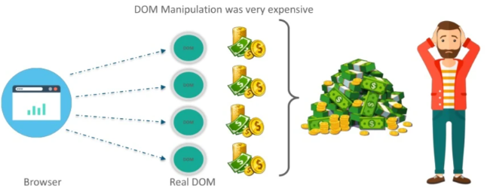
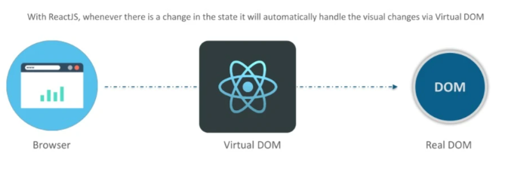
Without React.js vs With React.js
Q. Without react.js?
In traditional JavaScript, every UI update directly modifies the Real DOM. The problem is that the DOM is slow.
And DOM manipulation was very expensive.
Q. With react.js?
React does not update the Real DOM directly.
Instead of it uses virtual dom.
Keeps UI fast and smooth, even in large applications.

Slide 7
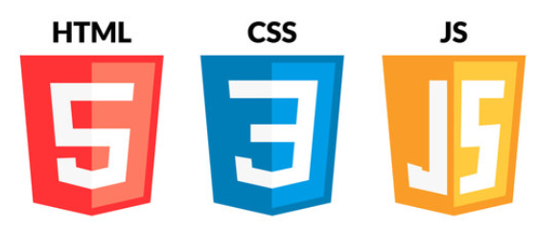
Prerequisites for Learning React.js
HTML, CSS, JAVASCRIPT:
HTML (Hyper Text Markup Language) – The structure of a webpage (e.g., headings, buttons, forms).
CSS (Cascading Style Sheets) – Used for styling the webpage (e.g., colors, layouts).
JavaScript (ES6+) – Arrow functions, let and const variables, template literals, destructuring (arrays & objects), spread and rest, modules (import/export), events, and event handling.

Slide 8
Library vs Framework
Q. What is Library?
A library is a collection of reusable functions or components that developers can use as needed.
React is a UI library that helps build components but does not dictate how the whole application should be structured.
Q. What is Framework?
A framework is a full-fledged system that provides rules and structure for building an entire application.
It controls the architecture, routing, and state management (e.g., Angular, Vue.js).

Slide 9
SPA vs MPA
Q. What is SPA?
A SPA stands for single-page application.
Loads a single HTML page and updates content dynamically without reloading the page.
Faster after the first load, as only necessary data is updated.
Uses client-side routing (React Router) to switch views without reloading.
Examples: Gmail, Facebook, Twitter, Netflix, YouTube Web App.
Q. What is MPA?
A MPA stands for Multi-page applications.
Each page is a separate HTML file, making navigation slower.
Slower performance, as the browser loads everything again on each page change.
Every new page request reloads the entire page from the server.
Uses server-side routing (URLs trigger full-page reloads).
Examples: Amazon, Wikipedia, News Websites, Banking Portals.

Slide 10
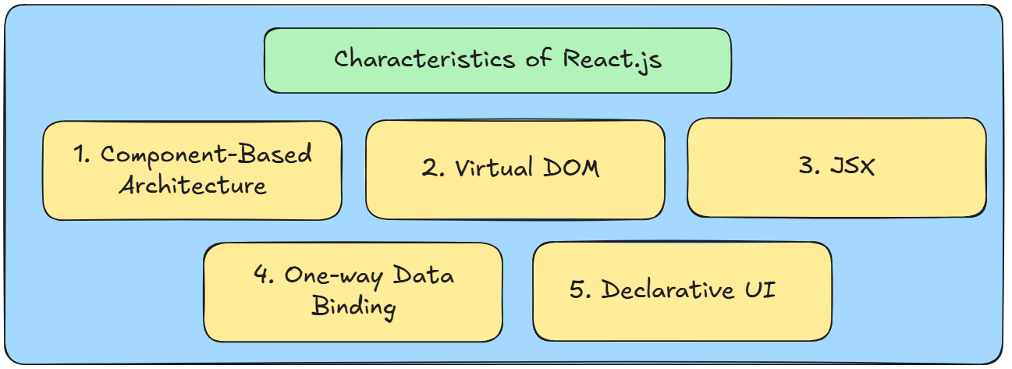
Characteristics of React js

Slide 11
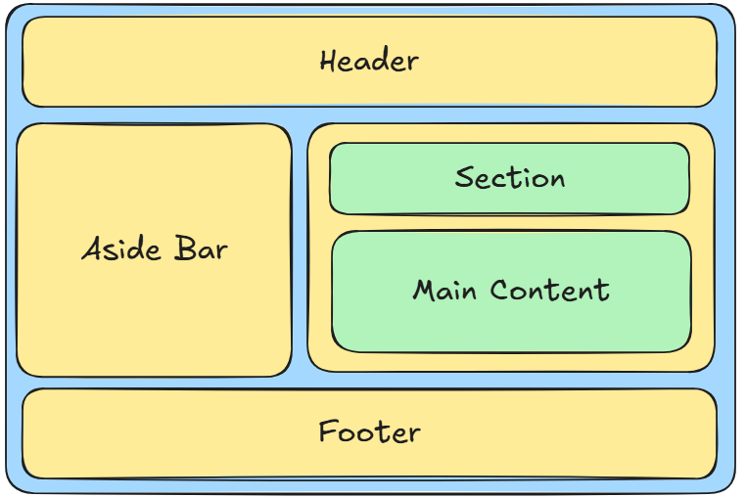
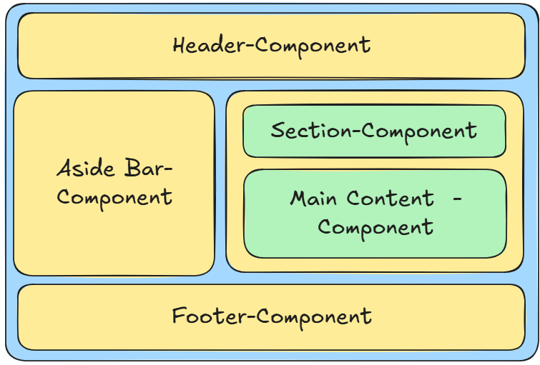
1. Component-Based Architecture

Slide 12
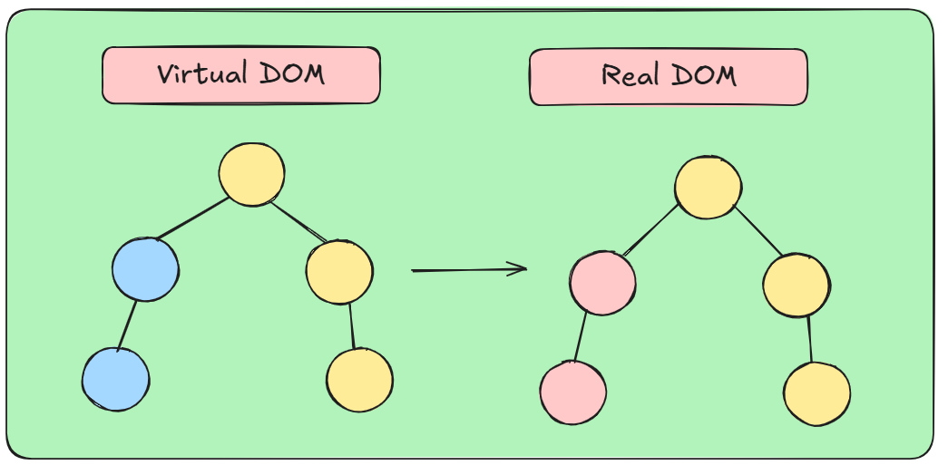
2. Virtual DOM
React uses a Virtual DOM to update only the changed parts of the UI.
Improves speed by avoiding direct manipulation of the Real DOM.
Example: Updating a single item in a list does not reload the entire page.

Slide 13
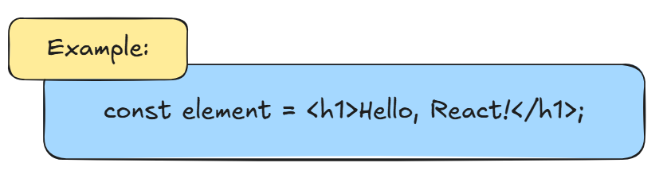
3. JSX
JSX stands for Javascript and XML.
JSX allows writing HTML-like syntax inside JavaScript.
Makes UI development more readable and declarative.

Slide 14
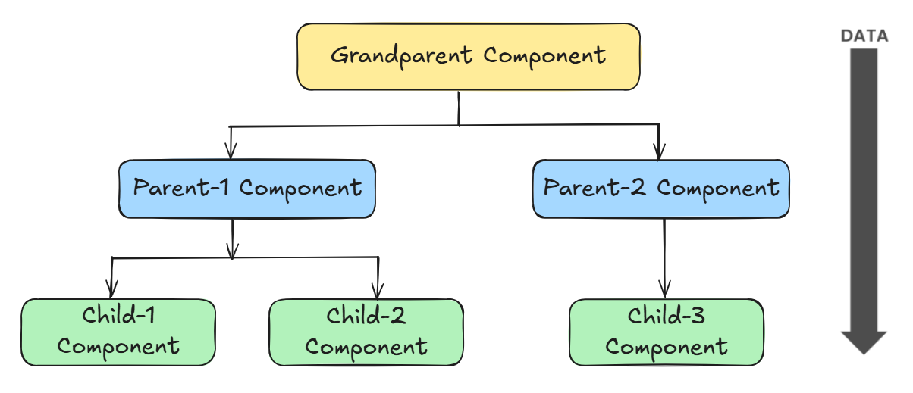
4. One Way Data Binding
Data flows in one direction (from parent to child components).
Example: A parent component passes data to a child component via props.

Slide 15
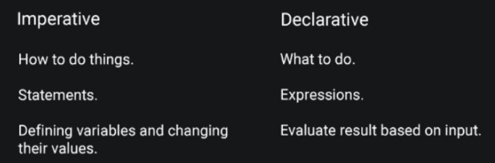
5. Declarative UI
React automatically updates the UI when data (state) changes.
Developers only describe what the UI should look like, and React handles the rest.

Slide 16
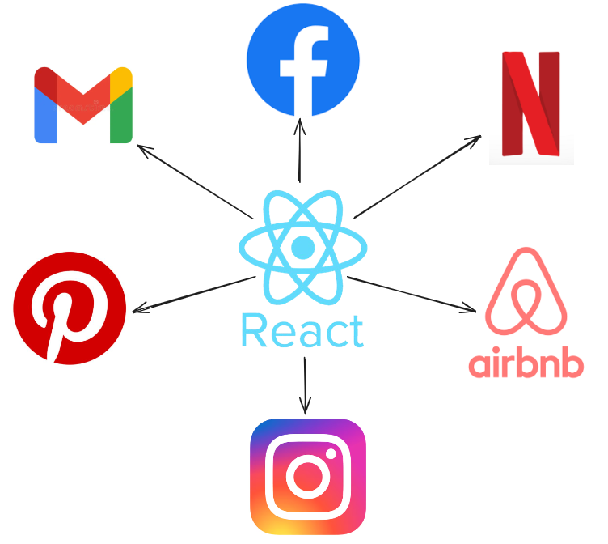
React js Applications

Slide 17

Installing React.js with Vite
`
Vite is frontend build tool and development server.
Vite is a faster and lightweight.
It provides better performance and a smoother developer experience.

Slide 18

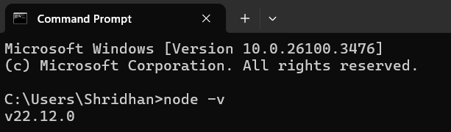
Step-1: Install Node.js
`
Before installing React, make sure Node.js is installed on your system.
After installation open command prompt (cmd) to check the version of installed node .js
Command: node -v
👉 If not installed, download it from: https://nodejs.org/

Slide 19
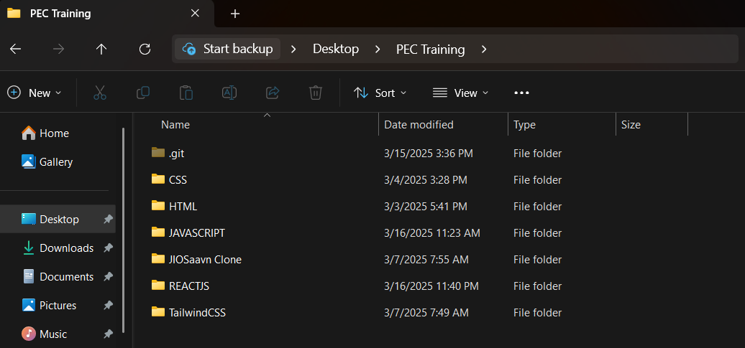
Step-2: Create a New Folder (name-Reactjs)
`
Create a new folder inside web tech program training folder.
Name of the folder - Reactjs

Slide 20
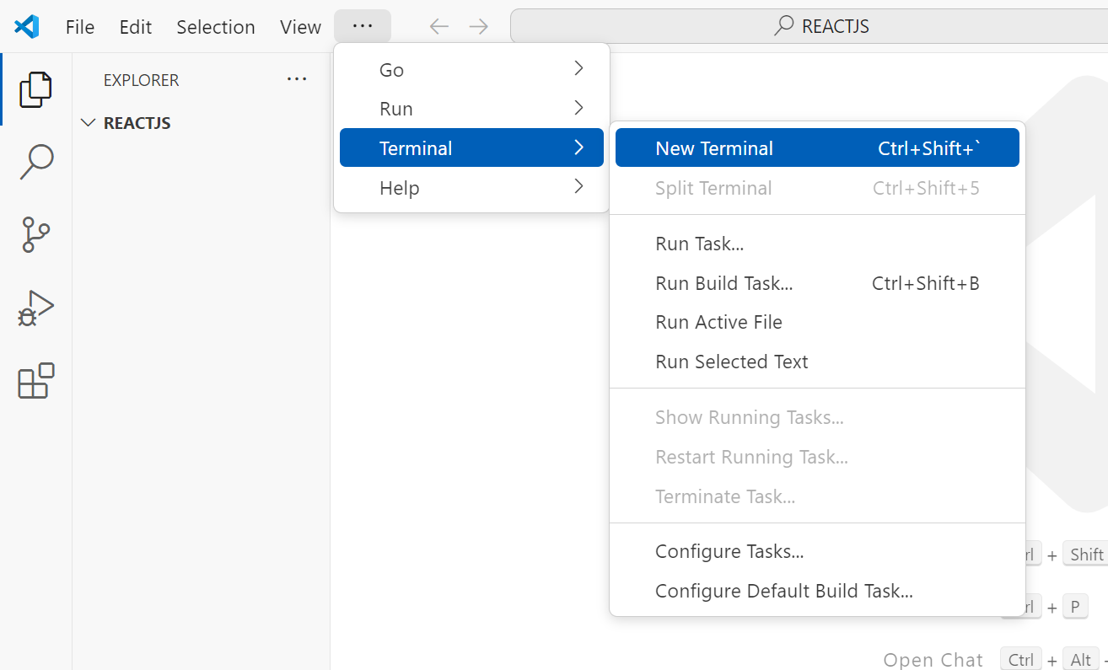
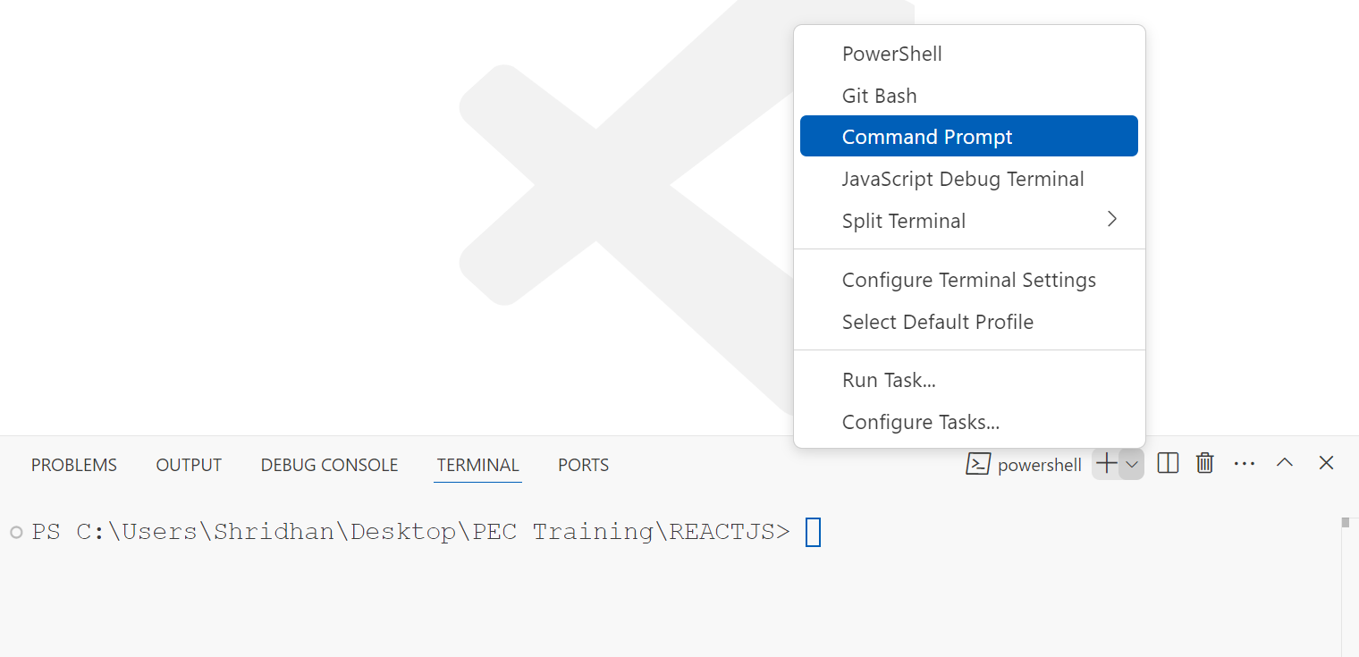
Step-3: Open this folder inside the vs code
`
Click Terminal – New Terminal
Click (+) icon and open the command prompt not Powershell.

Slide 21
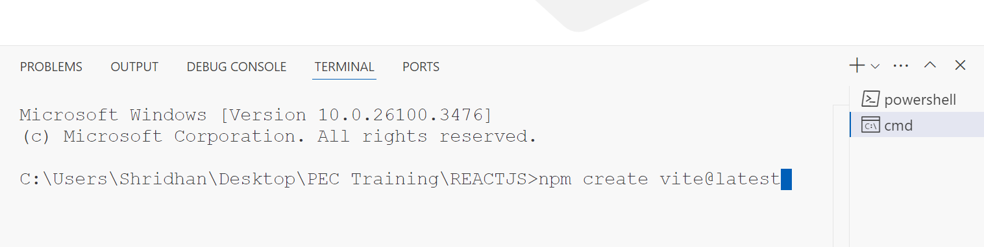
Step-4: Run the following command in cmd
`
Command: npm create vite@latest
And just enter on keyboard.

Slide 22
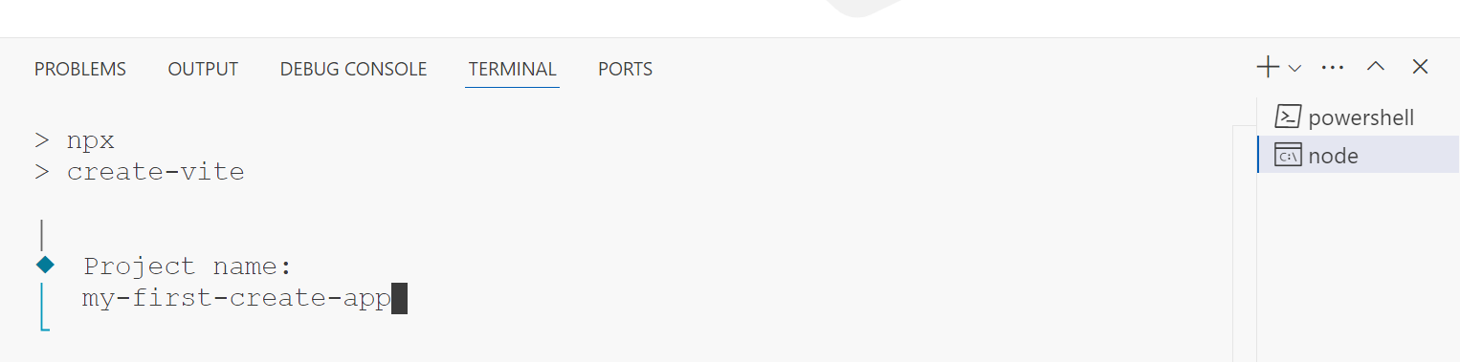
Step-5: Packages and Project Name
`
It will ask to install some packages, you have to give the permission by typing:
Ok to proceed: y
Then after hitting enter it will ask for project name.
Give the project name whatever you want.
For Example - Project name: my-first-create-app

Slide 23
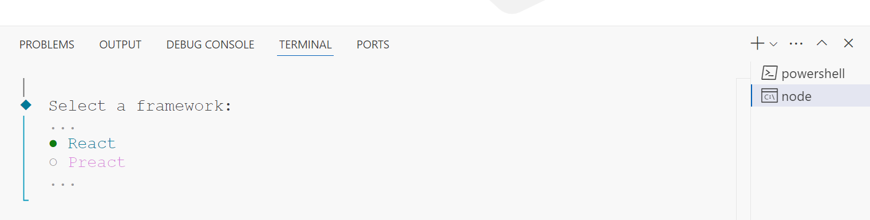
Step-5: Select a framework
`
After giving name it will ask the select a framework.
Only Select – React
How to select ? – Use down arrow key on keyboard for selecting option react option.
For Example – Select a framework: React

Slide 24
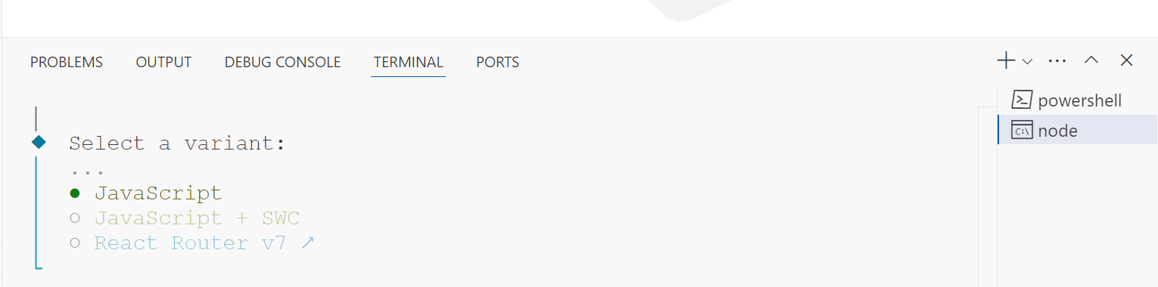
Step-5: Select a variant
`
After selecting a framework it will ask for you variant.
Variant is nothing but which language you are going to use in react js
How to select ? – Use down arrow key on keyboard for selecting option javascript option.
For Example – Select a variant: Javascript (✅)
Don’t select Javascript+swc (❌)

Slide 25
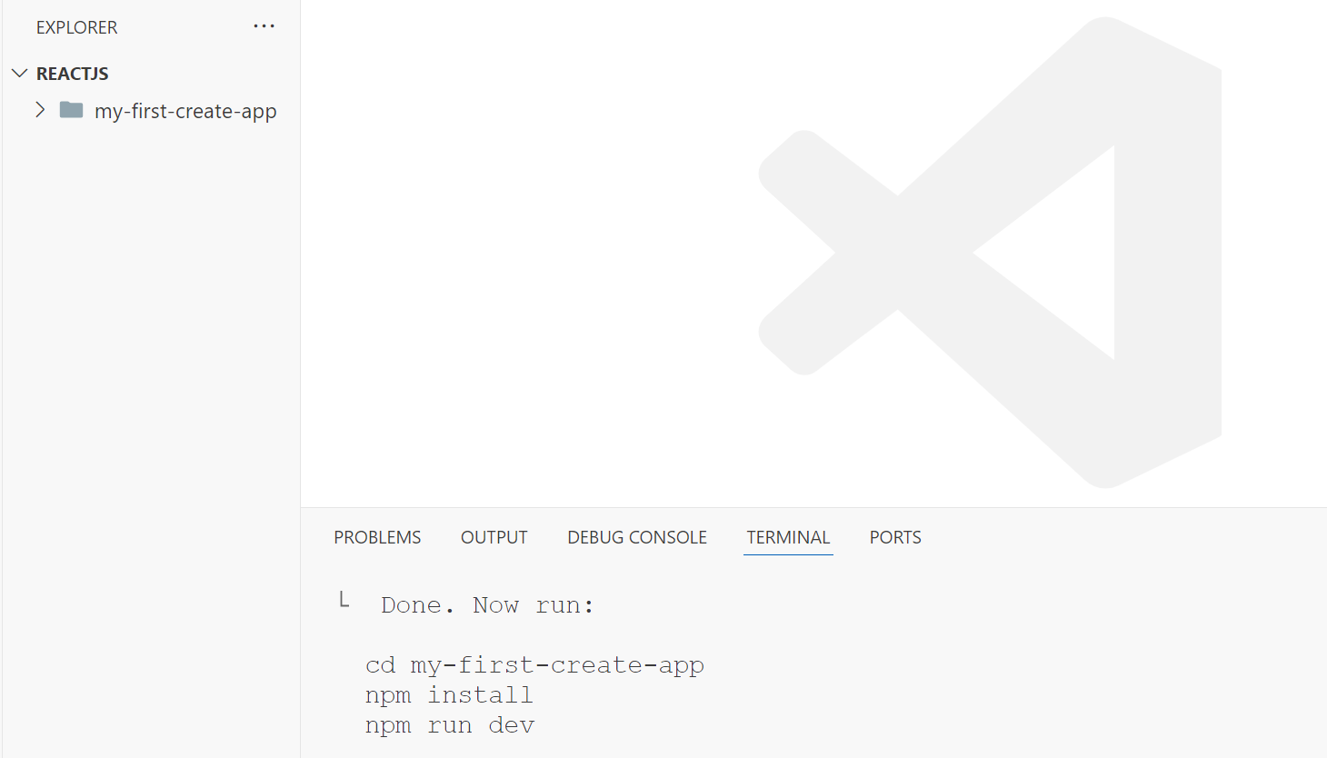
Step-6: 3 commands will be created
`
After that it will create one folder inside the main react js folder.
You will able to see the 3 commands in the terminal.
Now use step-7 on next slide

Slide 26
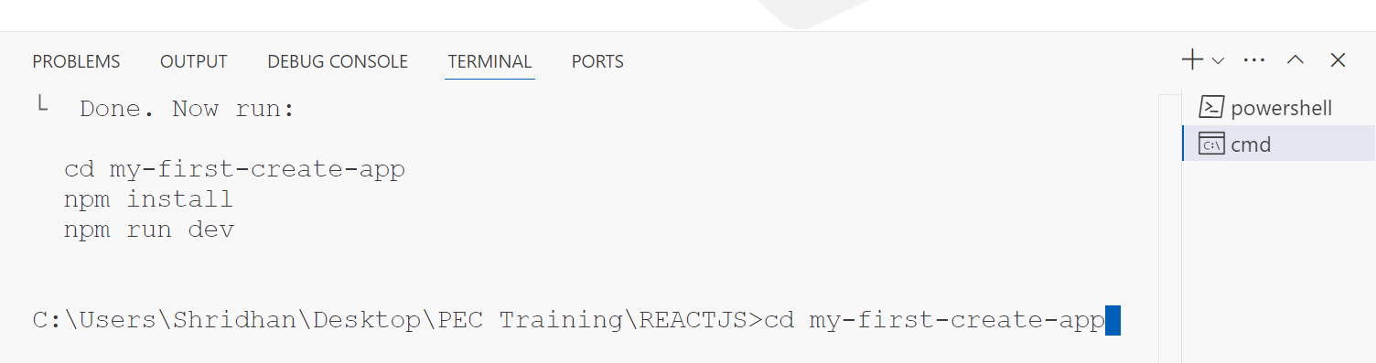
Step-7: Use first command
`
Copy the first command and paste in cmd.
After that hit enter on the keyboard.

Slide 27
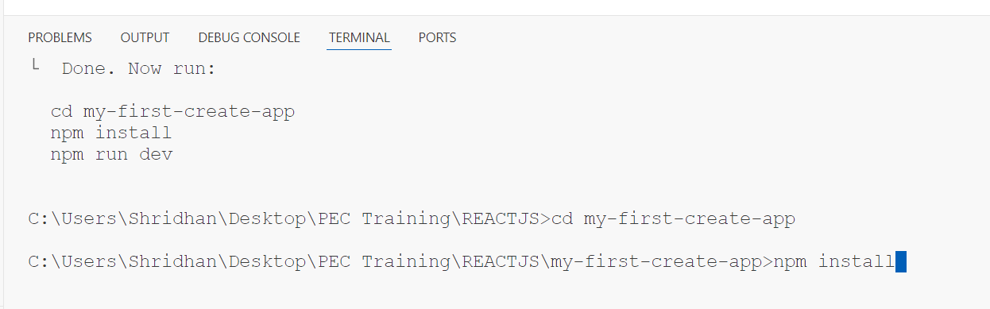
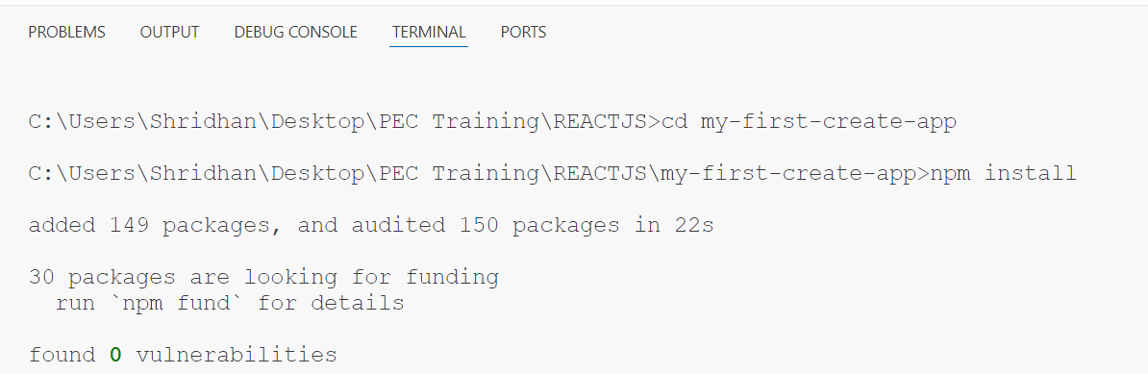
Step-8: Use second command
`
Now you are entered in the react project folder.
Copy the second command and paste into the cmd.
And hit enter, it will install important packages which will help to run the react project.
Command : npm install (It will create one node-modules folder)
It will take some tine to install the packages. so wait for some time. (It might takes some minutes also, it depends upon your internet speed)
After Installation

Slide 28
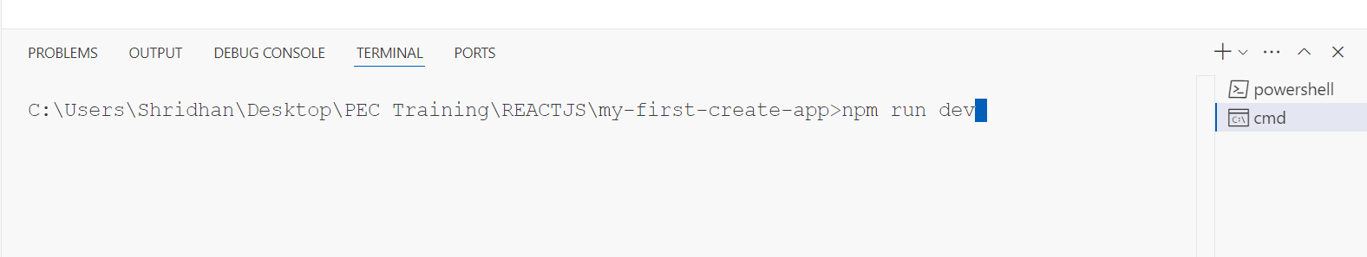
Step-9: Use third and last command
`
Now you can right side image, your folder structure will look like this.
That means you have created your first react app.
To run react project you need last command copy the command and hit enter.
Command: npm run dev

Slide 29
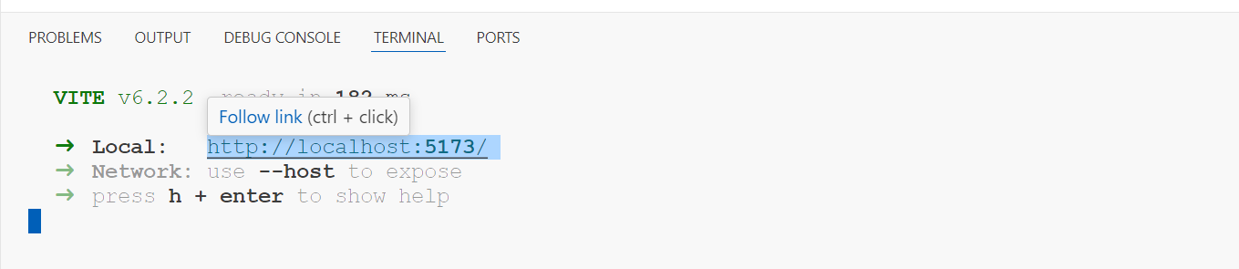
Step-10: Copy the link and Paste into browser
`
After the step-9 it will create one link.
Just copy the link and paste it into the browser.
Now you can see react project is running on the browser successfully.
Copy this link paste in the browser

Slide 30
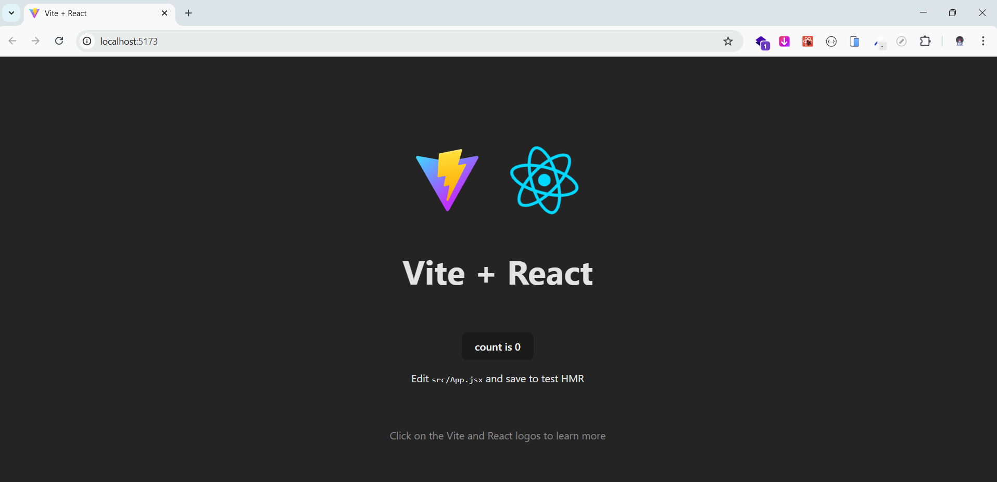
Congratulations you have created first react project
`

Slide 31
React.js
DAY-2
Topics Covered:
React Folder Structure
React Folder Setup
JSX and JSX Rules
Fragments
JSX Expression
Components
List and Keys
Props

Slide 32
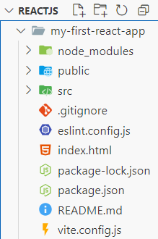
React Folder Structure
`
Main React folder
Stores all installed dependencies (auto-generated).
Contains static data likes images, and icons.
Main Source code folder (Components, styles, and logic)
Specifies files Git should be ignored. (e.g. node_modules)
Configuration of ESLint (Code linting and formatting)
The main HTML file where React attaches
Auto-generated file to lock dependency versions.
Defines project dependencies, scripts, and metadata.
Documentation for the project (how to use/setup).
Configuration file for Vite (fast build tool for React).

Slide 33
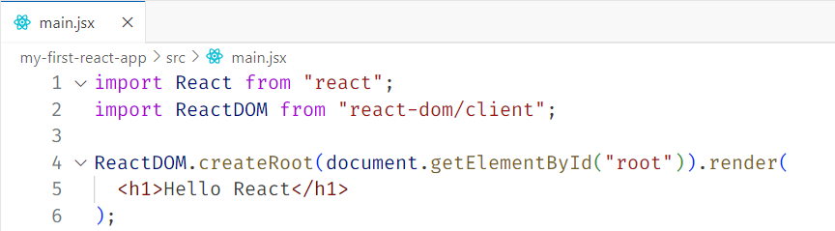
React Folder Setup
`
Open the project in vs code
Delete the src folder to remove any pre-provided jsx and js files
Create the src folder. This folder belongs to react.
Whatever code we have for react we need to write in src only with .jsx extension
Inside src, create main.jsx and App.jsx
To create react application, we need two important modules
1. react
2. react-dom/client

Slide 34
JSX (Javascript and XML)
`
JSX stands for Javascript and XML.
It is a syntax extension for JavaScript that looks like HTML but works inside JavaScript.
This syntax allow us to write html code in react.
It looks similar to html but it is not.
Without jsx it is very difficult to create react application.
Q. Why do we need JSX?
Easier to write and read UI components
Allows us to write down mix code of javascript logic with UI components

Slide 35

Rules of JSX:
`
JSX must have one parent element
Self-Closing tags must have a /
Use {} for Javascript expressions
JSX attributes use camelcase convention
To provide class in react we have to use className as class is a keyword in javascript.
To link your label with input tag, we have to use for as htmlFor as for is a keyword in javascript.
User defined custom components should be in PascalCase.

Slide 36
What is Fragment in React.js?
`
A fragment in react is used to group multiple elements without adding an extra DOM node like a <div>.
Fragment is not a html element, it is react component.
We can not pass id or any other attribute to it. It is not adding to the DOM, then how can we pass any attribute to it.
It accepts only one attribute that is key, we will see this key later.
If we want to provide attributes, we need to go with html elements.

Slide 37
Q. How to use Fragments?
`
Using <React.Fragment>
Using Short Syntax ( <> and </> )
Suggestion: A shorter way to use fragments is by using empty angle brackets. ( <> and </> )
Note: We cannot pass key attributes in short fragment syntax.

Slide 38
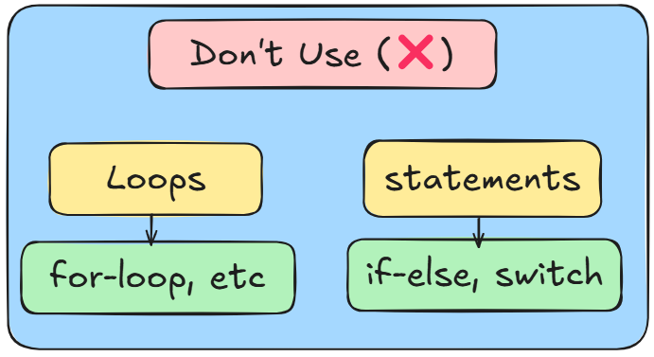
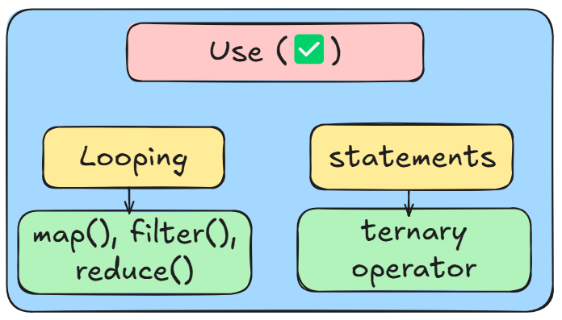
JSX Expression
`
To use js variables or js syntax in our jsx template, we have to use a pair of curly braces, this is called a jsx expression { }.
Don't take it as an object, a pair of curly braces in the jsx is a jsx expression.
Important Note: Inside expression we cannot render boolean/null/undefined but we can use with conditions.

Slide 39
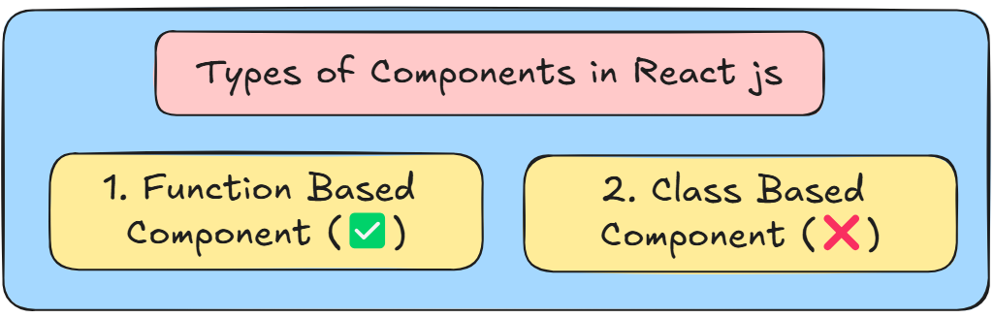
Components in React js
`
React follows component-based architecture.
A component in react is reusable, independent javascript functions that can be used multiple times within an application.
Components allows us to break down the UI into smaller parts.

Slide 40
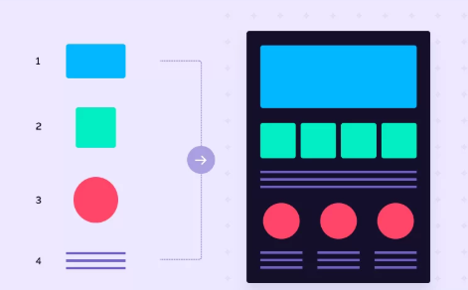
Components in React js
`

Slide 41
How to create component?
`
Create a new component file in the src folder - You should use the extension as .jsx only.
The first alphabet of the file name should be capital Eg - App.jsx
You can use the syntax of either class-based-component or function-based-component.
Then export your component.
And import it with proper address wherever you feel necessary and use it as custom defined tag (wrap inside angular braces)

Slide 42
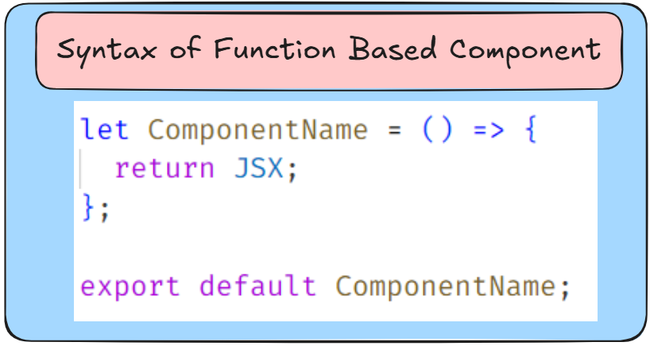
Function Based Component in React js
`
A functional component is just a Javascript function that returns JSX.

Slide 43

Extension – React Developer Tools
`
React Developer Tools is a browser extension that helps inspect and debug React components in real-time.
It allows developers to view component hierarchy, props, state, and performance, making debugging easier.

Slide 44
List and Keys in React js
`
Q. What are Lists in React?
In React, a list is a collection of items (like an array) that we render dynamically using .map()
Q. Why Do We Need Lists?
Helps display multiple items dynamically.
Makes UI updates efficient.
Useful for rendering data fetched from an API.

Slide 45
List and Keys in React js
`
Q. What are Keys in React?
In React, Keys are special attributes that help React identify which items changed, added, or removed.
Syntax: items.map((ele, index) => <Component key={index} />);
Important Note: A key should be unique for each list item.
Q. Why Do We Need Keys?
Improves performance by helping React update only the changed items.
Prevents unnecessary re-renders.
Helps React track elements efficiently in a list.

Slide 46
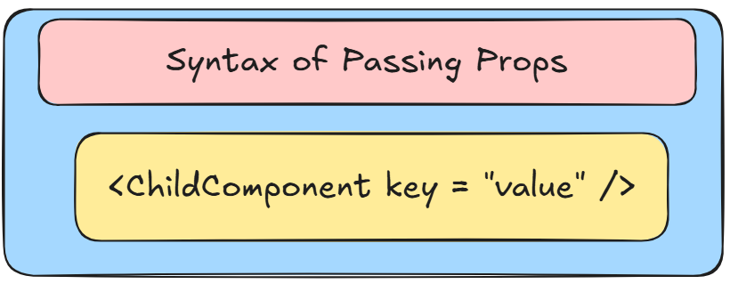
Props in React js
`
Props stands for properties in react js.
Props are used to pass data from a parent component to a child component in react. (Unidirectional Flow)
Props are read-only and help make components reusable and dynamic in nature.
We can pass any javascript value through props and it is send as an object.

Slide 47
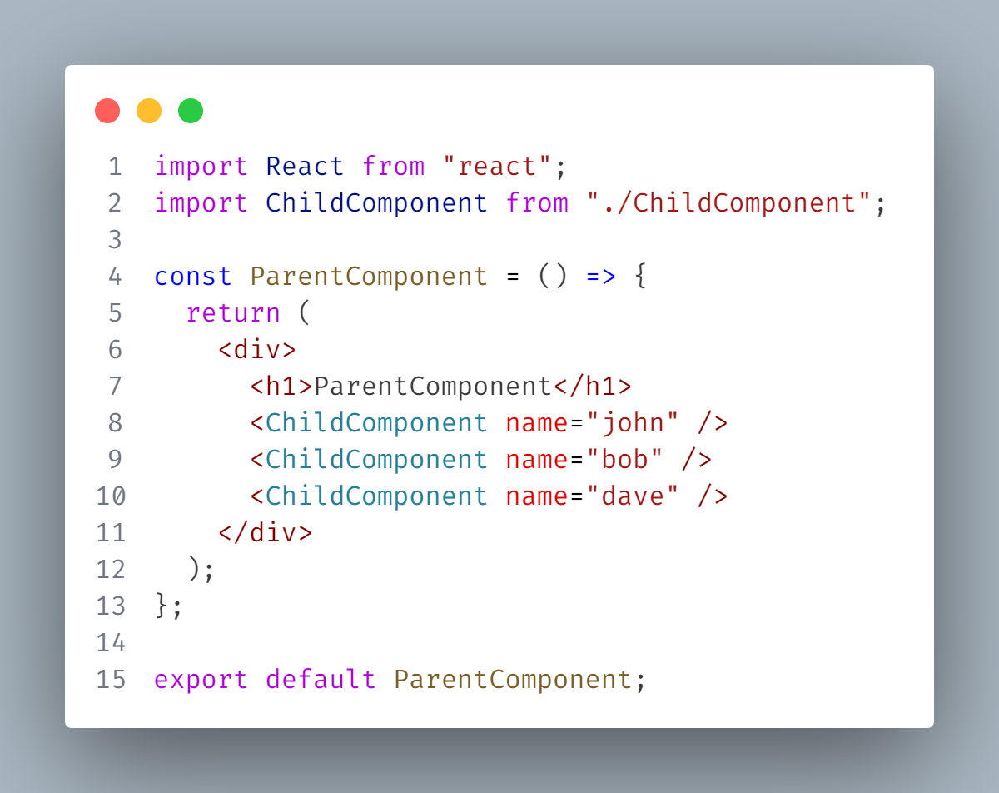
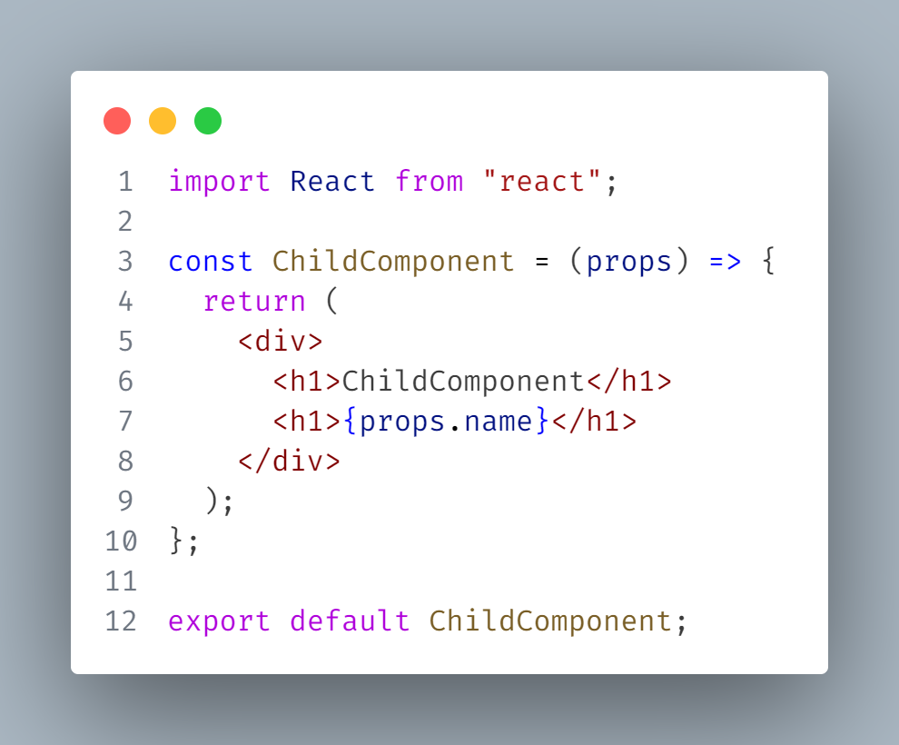
How to pass and consume props?
`
Passing Props
Consuming Props

Slide 48
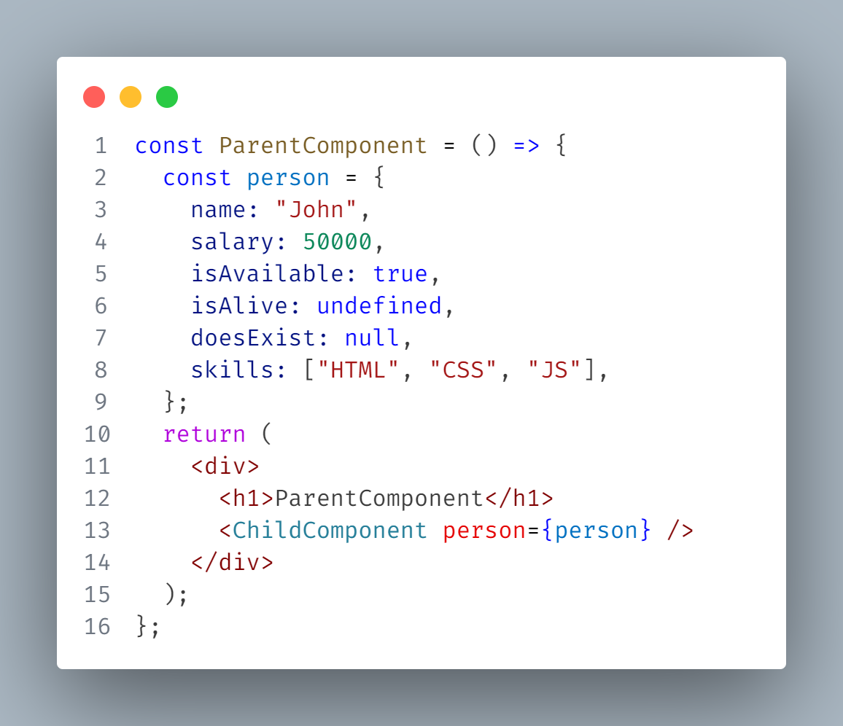
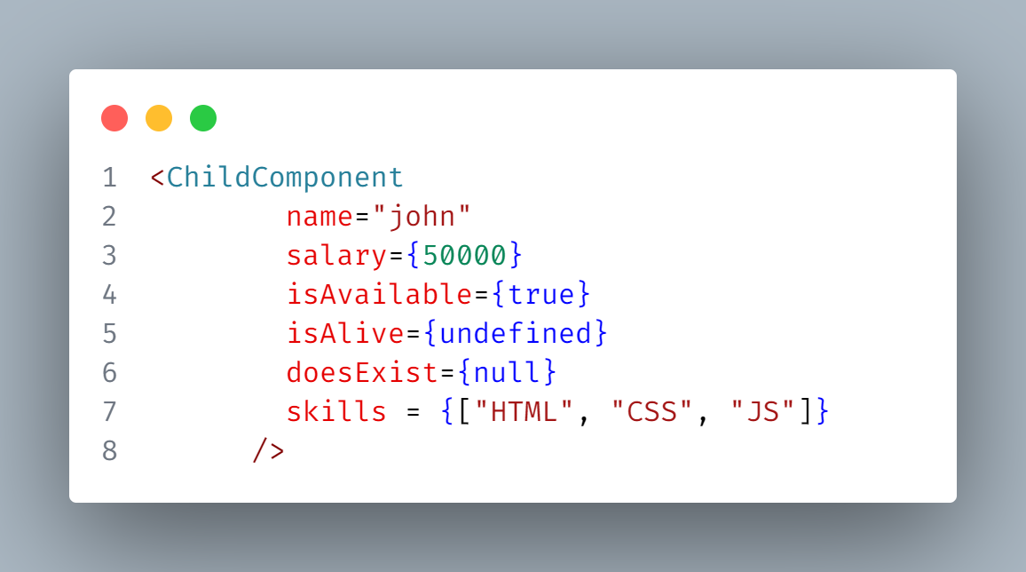
How to pass different javascript values as a prop
`
If you are passing string you can just pass it normally in quotes (“ ”), we can not use backticks.
If you want to send any data type other than string, we should go with expression ( { } ).
We need to wrap data inside jsx expression ( { } ).
We can also pass string in jsx expression.

Slide 49
Props Children
`
Till now we are using unpaired syntax for our custom tags, but what if we use the paired way and pass some content in between.
React automatically will convert that content into props and it will be present inside your props object in the children key.
This is called as props children.
You can access it through props.children in child component.
We can pass JSX only as content in props.children (between opening and closing custom tags).
The passed JSX is present in the form of array in the children key.

Slide 50
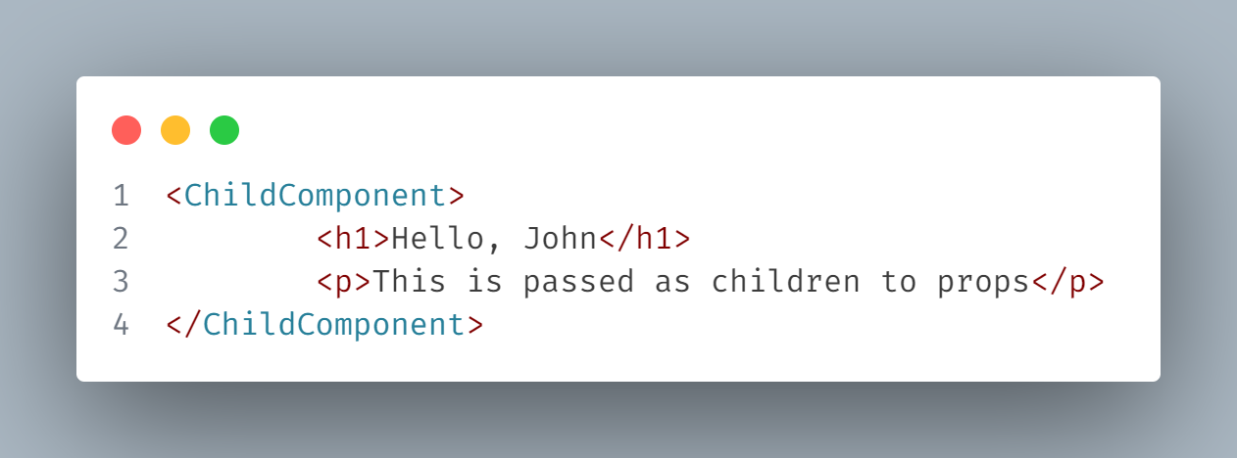
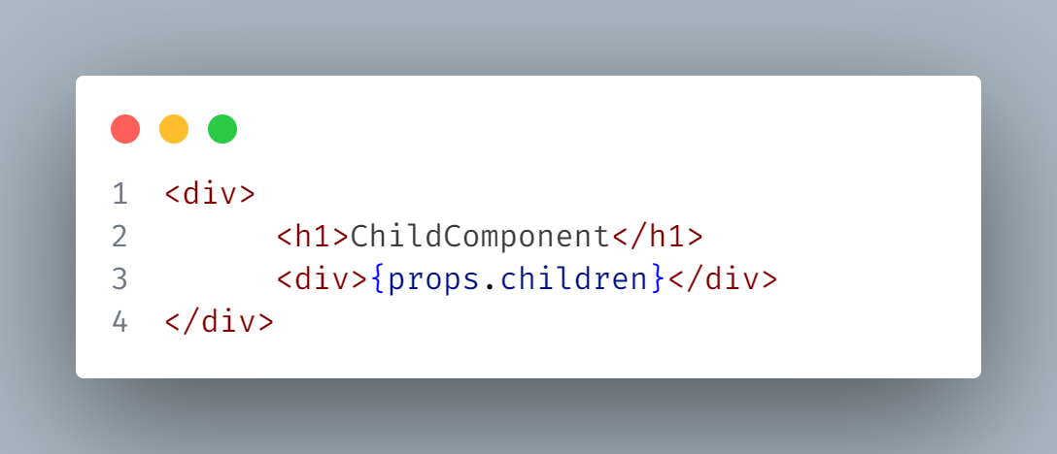
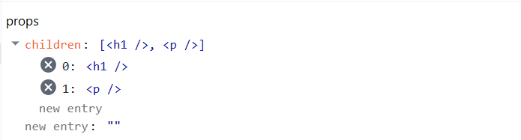
Props Children
`

Slide 51
React.js
DAY-3
Topics Covered:
Events in React
Event Handling in React
States
Conditional Rendering
Styling in React

Slide 52
Events in React
`
Events in React are user interactions such as clicks, key presses, or mouse movements.
React handles events using event listeners, similar to JavaScript, but with a slightly different syntax.
Important Points:
React events are named using camelcase (e.g. onClick, onChange)
Event handlers are functions that execute when an event occurs.
The event object (e) provides the information about the event.
The target property in the event object refers to the element that triggered the event.
Syntax – e.target

Slide 53
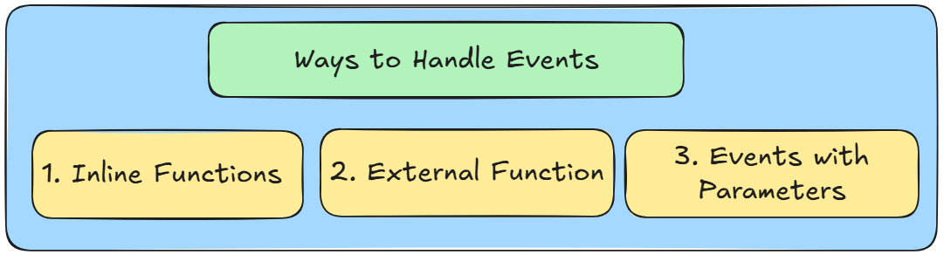
Events Handling in React
`
In react, event handling is similar to handing events in javascript but with some key differences.
React uses a SyntheticEvent, a wrapper around native events for cross-browser consistency.

Slide 54
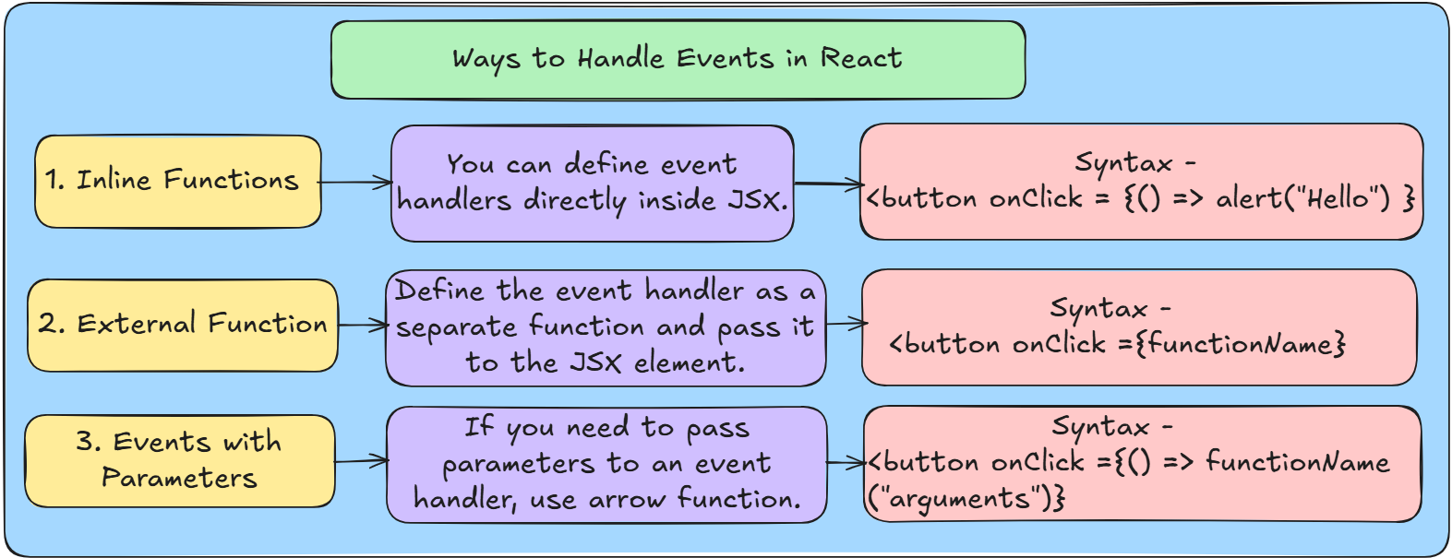
Events Handling in React
`

Slide 55
e.preventDefault() in React
`
In react, e.preventDefault() is used to prevent the default behaviour of an event.
This is commonly used in submissions forms, links clicks, and other default browser behaviors.
Syntax – e.preventDeafult();
Q. Why Use e.preventDefault()?
By default, some HTML elements have predefined behaviors:
Forms (<form>) – Refresh the page on submission
Links (<a>) – navigate to another page

Slide 56
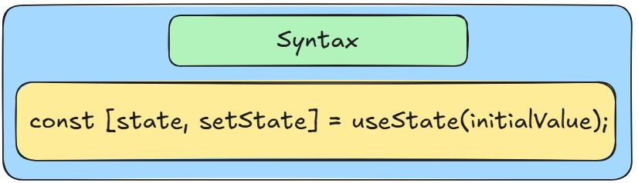
States in React
`
States is used to store and manage the component-specific data in react.
useState – It is a hook in react js which will handle state management in function based component.
state – Holds the current value or initial value
setState – It is a function which will update the current value

Slide 57
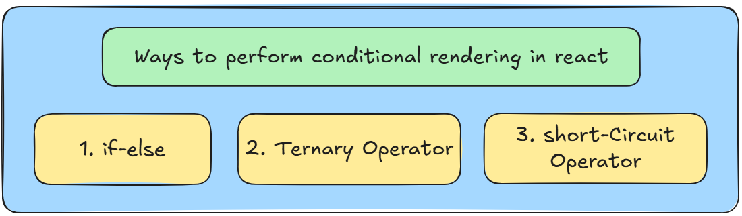
Conditional Rendering in React
`
Conditional Rendering, in react means showing different UI elements based on a condition.
Instead of rendering everything at once, React dynamically decides what to render.

Slide 58
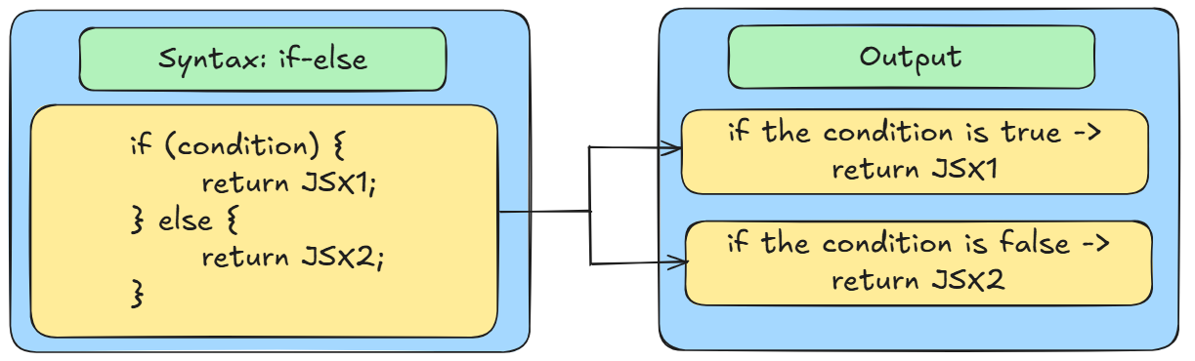
1. Conditional Rendering By Using if-else
`
If-else cannot be used inside JSX.
It works outside the return() statement of the component.

Slide 59
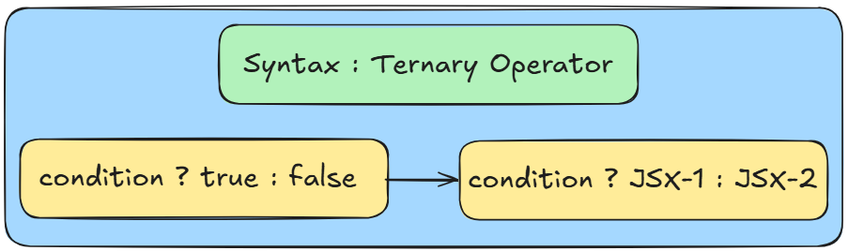
2. Conditional Rendering By Using Ternary Operator
`
The ternary operator is used as a shorter syntax for the if-else statement.
It works inside the JSX ({ }).

Slide 60
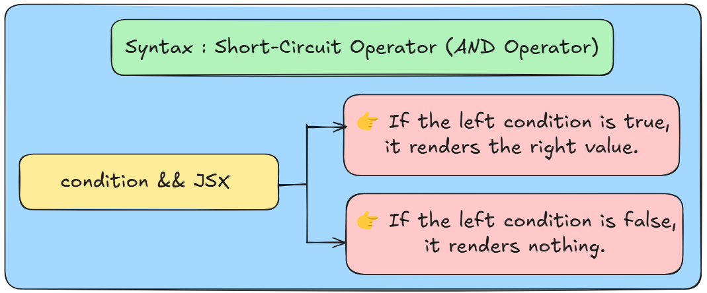
3. Conditional Rendering By Using Short-Circuit
`
Short Circuit (&&) (AND Operator).
The short-circuit operator works from left to right.
It works inside the JSX ({ }).

Slide 61
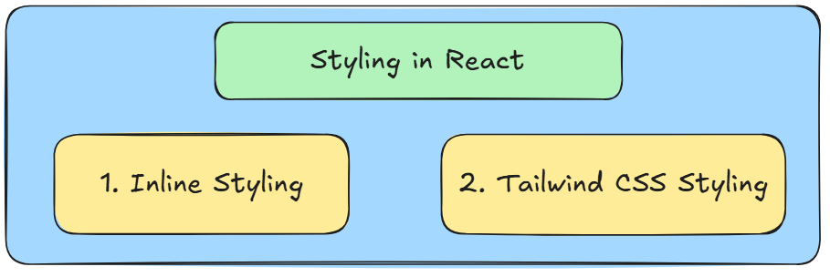
Styling in React
`
In react, you can style the components by using CSS.
There are 2 ways you can provide the styling in react:

Slide 62

1. Inline Styling in React
`
Inline styles in React are written as Javascript Objects inside the style attribute.
Javascript object means key and value pair.
Key – propertyName (camelCase convention)
Value – “value” (In String)

Slide 63

2. Installation for Tailwind CSS for React
`
First close your project (terminate the project in terminal by clicking ctrl+c – then type y and hit enter)
Go to this website - https://tailwindcss.com/docs/installation/using-vite
You will see this type of UI.

Slide 64


Step-1: Copy the first command
`
Copy the first command and open new terminal - Command prompt – and paste the command and hit enter.

Slide 65

Step-2: Copy the 2nd import statement
`
Copy the 2nd import statement only - import tailwindcss from '@tailwindcss/vite‘
Then go to vs code you will see file vite.config.js at the last of the project.
Open the file paste that import statement in the line no-3.

Slide 66

Step-3: Copy the tailwindcss()
`
Now copy the tailwindcss() from the plugins option.
After that go to vs code, vite.config.js – inside you can see already react is their provide one comma (,) and paste that tailwindcss() their itself.
Before
After

Slide 67

Step-4: Copy the 3rd command and paste in global.css
`
Now create one file inside the src folder. – filename - global.css
Inside that paste the 3rd command - @import "tailwindcss";

Slide 68

Step-5: Now import that global.css in main.jsx
`
Now import that global.css file import inside the main.jsx file.
Or you can type exact same import statement inside your code in line-4

Slide 69

Step-6: Finally run the react project – npm run dev
`
Tailwind installation done for your system.
Now just run the react project in terminal – command prompt – npm run dev
Open the link in the browser that it done.

Slide 70

For those who are getting errors
`
If your are getting error like lightningcss module not found.
Type Microsoft redistribute package in any browser and click on the first link.

Slide 71

For those who are getting errors
`
Next thing just scroll the page you will see this type of one box.
In the terminal, just check what it the version error coming and it may be asking like x64 or x86 according that just click on the link and download that package in your system.

Slide 72

For those who are getting errors
`
After downloading just check the I agree and click on the install button.
After the completion of installation just restart your laptop.
Open the vs code and run the react project now that error will not come.

Slide 73
React.js
DAY-4
Topics Covered:
Forms Handling in React
Key things required (4)
Fields to handle in forms
type = text, email, password
type = radio
type = select

Slide 74
Forms Handling React
`
Form handling in react means managing the input fields (like text, email, password, radio, select, etc) and their values when a user types something.
It includes:
Capturing user input
Updating the state when input changes
Submitting the form

Slide 75

Forms Handling React
`
To handle forms in React properly, we need four key things:

Slide 76
Forms Handling React
`
1. State :
The state holds the form's input values.
It updates whenever the user types something in the input fields.
2. onChange event :
The onChange event updates the state when the user types something in the input field.
3. value attribute :
The value attribute binds the input field to the state.
4. name attribute :
The name attribute helps identify the input field and allows us to update the correct state property.

Slide 77
React.js
DAY-5
Topics Covered:
useEffect()
Context API

Slide 78
useEffect()
`
The useEffect() is the React Hook.
It allows us to run code after the component renders.
It is mainly used for:
Fetching data from an API
Changing the document title

Slide 79
What Happens If we don’t use useEffect() Hook
`
If we put API calls directly inside the component, they will run on every re-render.
Infinite API requests
Unwanted side effects

Slide 80

useEffect() Hook
`
No dependency array – Runs every render
Empty ([ ]) array – Runs only once
Dependency Array with values – Runs when dependencies change

Slide 81

Context API in React
`
Context API is a way to share data (state) between multiple components without passing props manually at every level.
Think of it like a global storage for your app.

Slide 82

Why Do We Need Context API?
`
Normally, we pass data from parent → child → grandchild using props.
But in large applications, this can be difficult (called "prop drilling").
Context API helps avoid this by providing data directly to any component that needs it.

Slide 83

Steps to Create Context API
`

Slide 84
Steps to Create Context API
`
Create Context: const MyContext = createContext();
Provide Data: <MyContext.Provider value={data}>{children}</MyContext.Provider>
Consume Data: const data = useContext(MyContext);

Slide 85


How to install react icons
`
Open terminal – new terminal – command prompt – npm install react-icons
Type react icons on any browser click on the first link – React Icons

Slide 86



How to use toast notifications
`
Open terminal – new terminal – command prompt – npm install react-hot-toast
For success notification – toast.success(“msg”)
For error notification – toast.error(“msg”)
Don’t forget to import the <Toaster/> component inside the main.jsx component.
Without this toast notification will not work.

